Slide 1
Navanti Group: COVID-19 Sentiment Analysis & Visualization
Melis Diken, Zachary Vila, and Matias Roca-Guiulfo
04/29/2022

Slide 2
Outline
Fundamental Problem
Hypothesis
Framing & Methodology
Content Harvesting
Data Processing Approach
Delivery Vision
Dashboard Demo
Recommendations
Project Extrapolation

Slide 3
Motivation: COVID-19 misinformation has blurred the lines between “mainstream” and “fringe” media
One would expect “fringe” sources to remain isolated and largely rejected by the wider public
We observe the opposite - fringe narratives are making the leap into “mainstream” conversations and are therefore legitimized
Why it matters: the inflection point of fringe misinformation entering the mainstream has ramifications beyond COVID-19
Notes:
Fundamental Problem

Slide 4
Hypothesis: The circulation of “fringe” misinformation is influencing the “mainstream”
Prove: analysis of COVID-19 themes using ongoing data streams
Test: Juxtaposition of fringe and mainstream media sources using scientific sources as a baseline
Examine: view results through data visualization pipeline, draw conclusions, and take action
Notes:
2. Hypothesis

Slide 5
Framing: Bounding Our Analysis
Media Segmentation: division of information sources into 3 categories based on the nature of content they provide
Conceptual Definitions: what are fringe, mainstream, political, scientific?
Scoping: How many sources, what types, media platforms?
Re-evaluation: Does the model provide a mechanism to trace misinformation flows from fringe to mainstream?
Sampling: content should be both representative and reflect influential voices in social media
Notes:
3. Framing & Methodology

Slide 6
Content: Scoped User Data from Social Media
Key Aim: fidelity to the methodology
Twitter: Provide majority of mainstream & all scientific content
Gettr: Provide unfiltered fringe content
Control for information overlap and eliminate redundancies
Twitter/Getter, Entity/Personal account separation
Generate high volume, continuous content, working with the limitations of the respective social media APIs (e.g. Twitter rate limiting)
Retain sources from across the political spectrum
Notes:
4. Content Harvesting
Circle back with Navanti

Slide 7
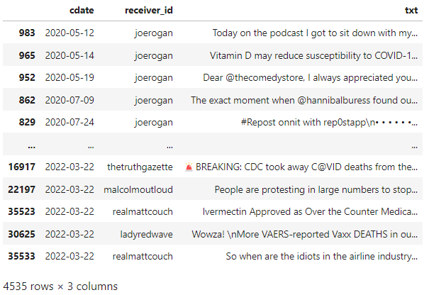
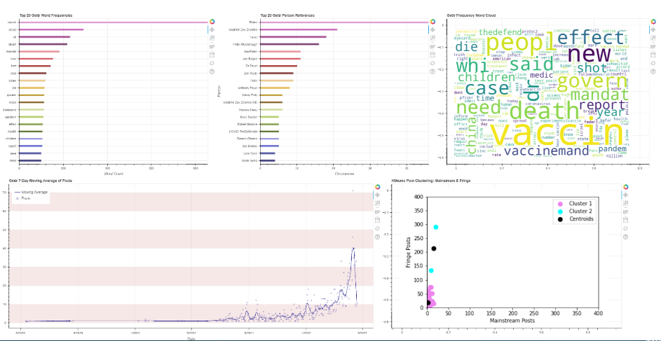
Data Processing Approach
Databases
APIs
Dashboards
1.) Collect initial posts from APIs with keywords since initial start date and add to pandas data frames
Twitter Database
Twitter API
Twitter Dashboard
Gettr API
2.) Use sqlite to convert data frames into databases
Gettr Database
4.) Query data from each database to display visualizations on the Twitter dashboard and Gettr dashboard using pre-defined visual layouts in Bokeh
Gettr Dashboard
3.) Append new posts with keywords from API every 2 mins to each database
Notes:
5. Approach

Slide 8
Delivery Vision
Browser accessible, server-based dashboard (Bokeh in Python)
Bar charts with top words used in Covid-19 posts
Bar charts with top people mentioned in Covid-19 posts
Time Series graphs showing different themes over time
K-Means Clustering to model differing sentiment
Pie chart with sentiment analysis segments of positive, negative, and neutral
Ability to filter by theme
e.g. Vaccines, Mandates, Organizations (e.g. CDC, NIH, FDA)
Ability to filter by Twitter Source Types (i.e. Mainstream, Fringe, Political, Scientific)
Notes:
6. Dashboard Visualizations

Slide 9
Dashboard Demo

Slide 10
Recommended Enhancements
Increase the size of fringe, mainstream, political and scientific sources so that they can be more reflective of each group
Identify additional keywords associated with Covid-19 that can be used to filter posts on Twitter and Gettr
Expand on filters for added targeting of analysis to key information areas
Ensure maintenance and expansion of project data capture, as analysis will improve as dataset grows
Additional data attributes (Retweets and Likes) could capture dissemination potential
Creating a logistic model to predict a user’s category
Using keywords we find in the Dashboard from each category as dummy variables to train the model
Notes:
9. Recommendations/Future Studies

Slide 11
Lessons Learned
Full functionality of Bokeh visualization suite, filtering, and callbacks
Importance of constant development team communication regarding code updates and expected outputs
Importance of justification when requesting access to restricted data sources (Twitter)
Network rules and command line interactions required to run a server application
Open-source tools available to build a low-cost dashboard using AWS
Notes:
8. Findings

Slide 12
“So What?”
Test the methodology used in this analysis with other events/topics where misinformation is also prevalent
2020 Presidential Election
2022 Russian invasion of Ukraine
National Security (U.S. Intelligence Agencies)
Expand (pandemic) targeted education programs to include campaigns combating misinformation and offset fringe narratives on social media
Provide education on the ideology shifting effects of high-volume, low-contrast misinformation on public opinion at large

